Slide 1
Budgeting 101
March 28, 2018
Presented by Henri Gearing, Coordinator Financial Services
ESC 15

Slide 2
Topics to be covered
Budgeting Legal Requirements
School Finance & the Template
What to look for in Budgeting
FIRST Report

Slide 3
Texas Law
As required by Texas Education Code §§44.002 and 44.004(a), a school district is required to adopt a budget for the next succeeding fiscal year by June 30th or August 31st.

Slide 4
Legal requirements from TEA
The superintendent is the budget officer for the district and prepares or causes the budget to be prepared.
The district budget must be prepared by a date set by the state board of education, currently August 31 (June 30 if the district uses a July 1 fiscal year start date). In order for the budget to be adopted by the board of trustees, inclusive of amendments, the district budget must be prepared by August 20 (June 19 if the district uses a July 1 fiscal year start date).

Slide 5
Legal requirements from tea
The president of the board of trustees must call a public meeting of the board of trustees, giving ten days public notice in a newspaper, for the adoption of the district budget. Any taxpayer in the district may be present and participate in the meeting.
Concurrently with the publication of notice of the budget above, a school district must post a summary of the proposed budget on the school district’s Internet website or in the district’s central administrative office if the school district has no Internet website. The budget summary must include a comparison to the previous year’s actual spending and information relating to per-student and aggregate spending on instruction, instructional support, central administration, district operations, debt service, and any other category designated by the commissioner. (Section 44.0041, TEC).

Slide 6
School funding is dependent on:
ADA – Average Daily Attendance
Property Values Certified from your CAD (County Appraisal District) and therefore tax collections
State Funding Formulas

Slide 7
Template funding elements
 | Funding Elements | 2016-17 |  | 2017-18
Students |  | Data Entry |  | Data Entry
Refined ADA (PreK - 12) |  | 119.842 |  | 111.179
High School Refined ADA (Grades 9 thru 12 only) |  | 38.900 |  | 40.450
Special Education Instructional Arrangement FTEs:
Homebound (Code 01) |  | 0.000 |  | 0.000
Hospital Class (Code 02) |  | 0.000 |  | 0.000
Speech Therapy (Code 00) |  | 0.136 |  | 0.172
Resource Room (Code 41,42) |  | 2.738 |  | 2.974
S/C Mild/Mod/Severe (Code 43, 44, & 45) |  | 0.487 |  | 0.413
Off Home Campus (Codes 91-98) |  | 0.000 |  | 0.000
VAC (Code 08) |  | 1.441 |  | 0.000
State Schools (Code 30) |  | 0.000 |  | 0.000
Nonpublic Contracts |  | 0.000 |  | 0.000
Res Care & Treatment (Code 81-89) |  | 4.874 |  | 3.925
Mainstream ADA |  | 2.017 |  | 1.116
Career & Technology FTEs |  | 11.436 |  | 8.550
Advanced Career & Technology FTEs |  | 0.000 |  | 0.000
Compensatory Ed Enrollment |  | 64.670 |  | 74.170
FTEs of Pregnant Students |  | 0.000 |  | 0.000
Bilingual ADA |  | 2.090 |  | 0.741
G & T Enrollment |  | 5.167 |  | 3.000
Public Ed Grant Student ADA |  | 0.000 |  | 0.000

Slide 8
Estimate tax collections for 2018-2019
2017 TAX YR
PRELIMS
52,346,523
53,857,273
52,346,523
52,346,523
53,857,273
53,857,273
2018-19
1.1700
600,205
0
0
0.0000
0
0

Slide 9
Certified appraised values
Staff |  | 2016-17 |  | 2017-18 |  | 2018-19 |  | 2019-20
# of Full-time Employees (excluding admin & teachers, etc) |  | 8.300 |  | 8.300 |  | 8.300 |  | 8.300
# of Part-time Employees (excluding administrators) |  | 0.000 |  | 0.000 |  | 0.000 |  | 0.000
 |  | 2015 TAX |  | 2016 TAX |  | 2017 TAX YR |  | 2018 TAX
Property Values - (Loaded thru 17-18) |  | YEAR |  | YEAR |  | PRELIMS |  | YEAR
State Certified Property Value ("T2" value) @ $25K Exemption |  | 45,885,653 |  | 48,542,086 |  | 52,346,523 |  | 52,346,523
State Certified Property Value ("T1" value) @ $15K Exemption |  | 47,236,663 |  | 49,977,856 |  | 53,857,273 |  | 53,857,273
State Certified Property Value ("T4" value) @ $25K Exemption |  | 45,885,653 |  | 48,542,086 |  | 52,346,523 |  | 52,346,523
State Certified Property Value ("T10" value) @ $25K Exemption |  | 45,885,653 |  | 48,542,086 |  | 52,346,523 |  | 52,346,523
State Certified Property Value ("T3" value) @ $15K Exemption |  | 47,236,663 |  | 49,977,856 |  | 53,857,273 |  | 53,857,273
State Certified Property Value ("T9" value) @ $15K Exemption |  | 47,236,663 |  | 49,977,856 |  | 53,857,273 |  | 53,857,273

Slide 10
Template estimate
State Aid by Funding Source
 | Fund Code/Object Code - Funding Source
47. | 199/5812 - Foundation School Fund |  | $1,017,540
48. | 199/5811 - Available School Fund |  | $24,755
49. | 599/5829 - Existing Debt Allotment (EDA) (Link to Detail Report) |  | $0
50. | 599/5829 - Instructional Facilities Allotment (IFA) (Bond) (Link to Detail Report) |  | $0
51. | 599/5829 - Instructional Facilities Allotment (Lease Purchase) (See Link Above) |  | $0
52. | I&S Hold Harmless (ASAHE for Facilities on TEA's Report) (see HH1718-Calcs tab) |  | $0
53. | TOTAL 2017-18 FSP/ASF STATE AID |  | $1,042,295

Slide 11
REvenue
Available School Fund – per capita – template
Foundation School Program – template
Local Taxes – County Appraisal District
  Current
  Delinquent
  Penalty & Interest
Other Local Revenue
  Interest
  Athletic gate receipts
  Facility rental
  Gifts, donations
Misc

Slide 12
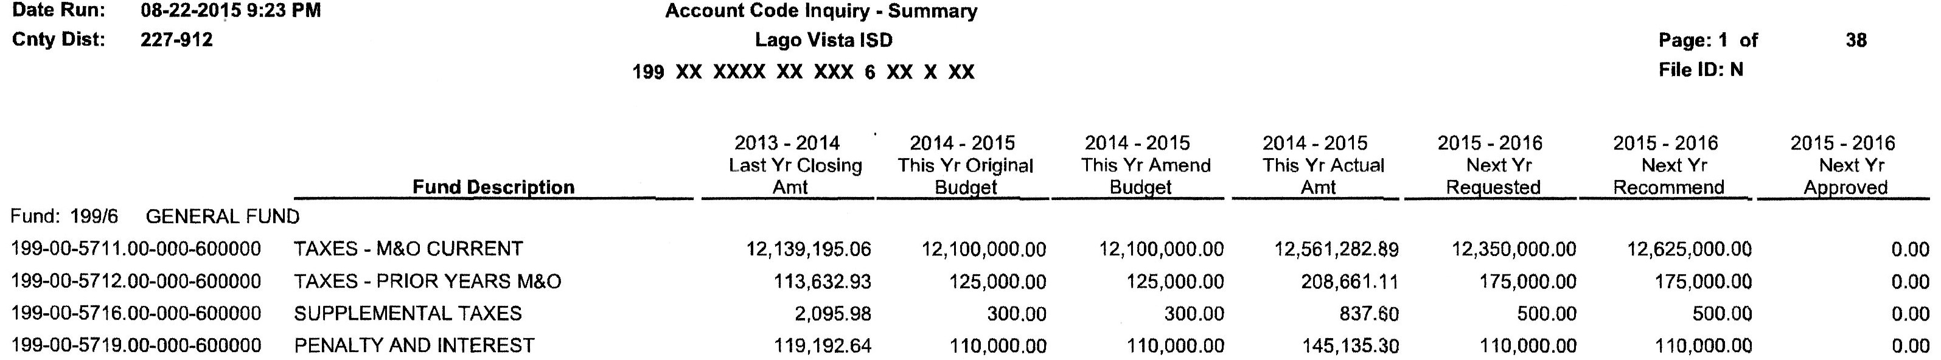
How it looks in the Budget system

Slide 13
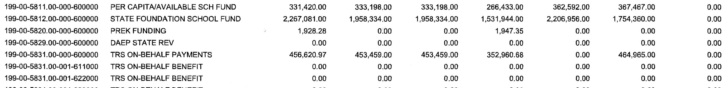
Local Revenue
13-14 14-15 14-15 14-15 15-16 15-16 15-16
Closing Original Amend Actual Request Rec Adopted

Slide 14
Expenditures
62XX – Contracted Services
  ESC
  TASB
  Professional Services
  Copiers
  Drug Testing
  Criminal History checks
  Other – i.e. AESOP

Slide 15
Expenditures
Electricity
Water
Propane
Insurance
Fuel
  Transportation
  Extra Curricular
Tax Office
County Appraisal District (CAD)
Chapter 41 Payments
Debt Service, Bond Payments, Principal, Interest
SSA

Slide 16
Expenditures
Legal Fees
Audit Fees
Technology
Extra Curricular
  Officials
  Post District
  Letter Jackets
  Travel
  Tournament fees
  Supplies/uniforms

Slide 17
Expenditures
Capital Purchases (over $5000)
  Buses
  Land/Property
  Equipment
    Athletics
    Band
Maintenance

Slide 18
Expenditures
Staff Development/Travel
  Teacher
  Student
Supplies
  Books
  Furniture
  Computers
  Testing materials
  Paper
  Postage

Slide 19
Expenditures
Repairs
Professional Organizations
Food Service
  Commodities
  Food
  Non Food
Equipment

Slide 20
Next Year Payroll
Salary Schedule
Step increase
TRS On Behalf
Stipends (verify)
Health Insurance
Other Benefits
Do by hand after NY Payroll interfaces with Budget
Substitutes –
Worker’s Compensation
Unemployment

Slide 21
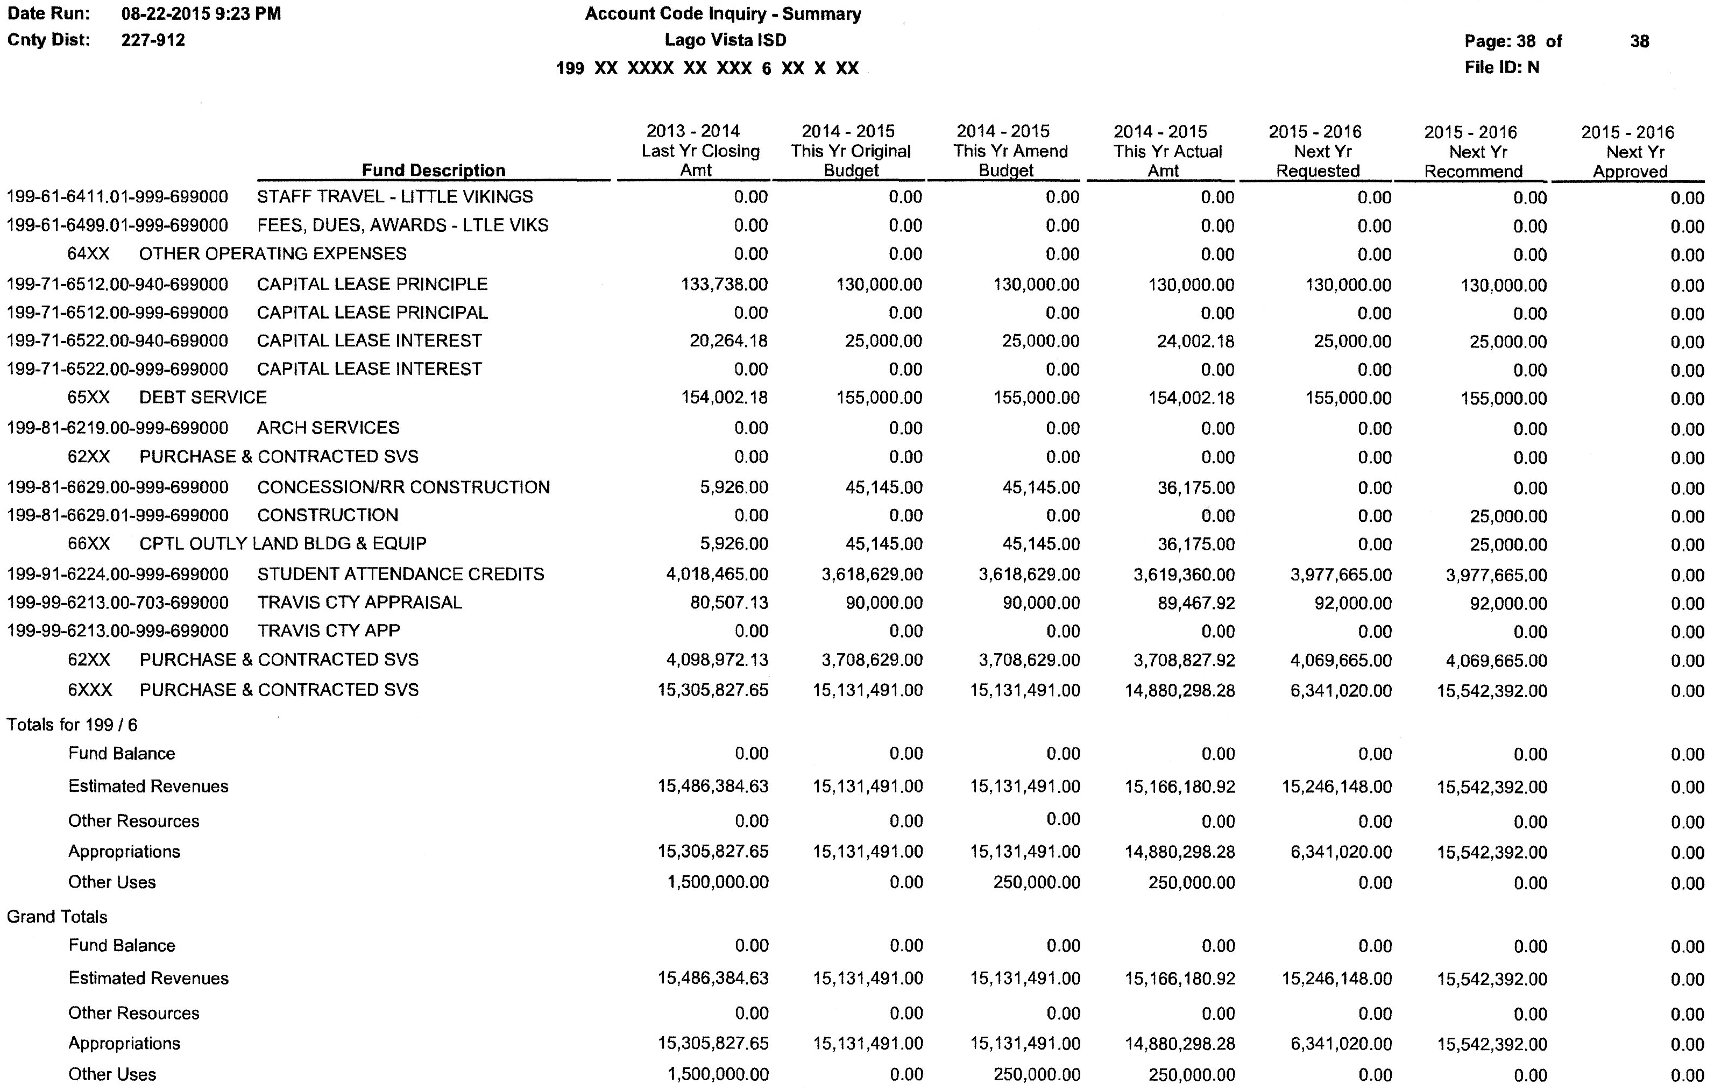

Slide 22
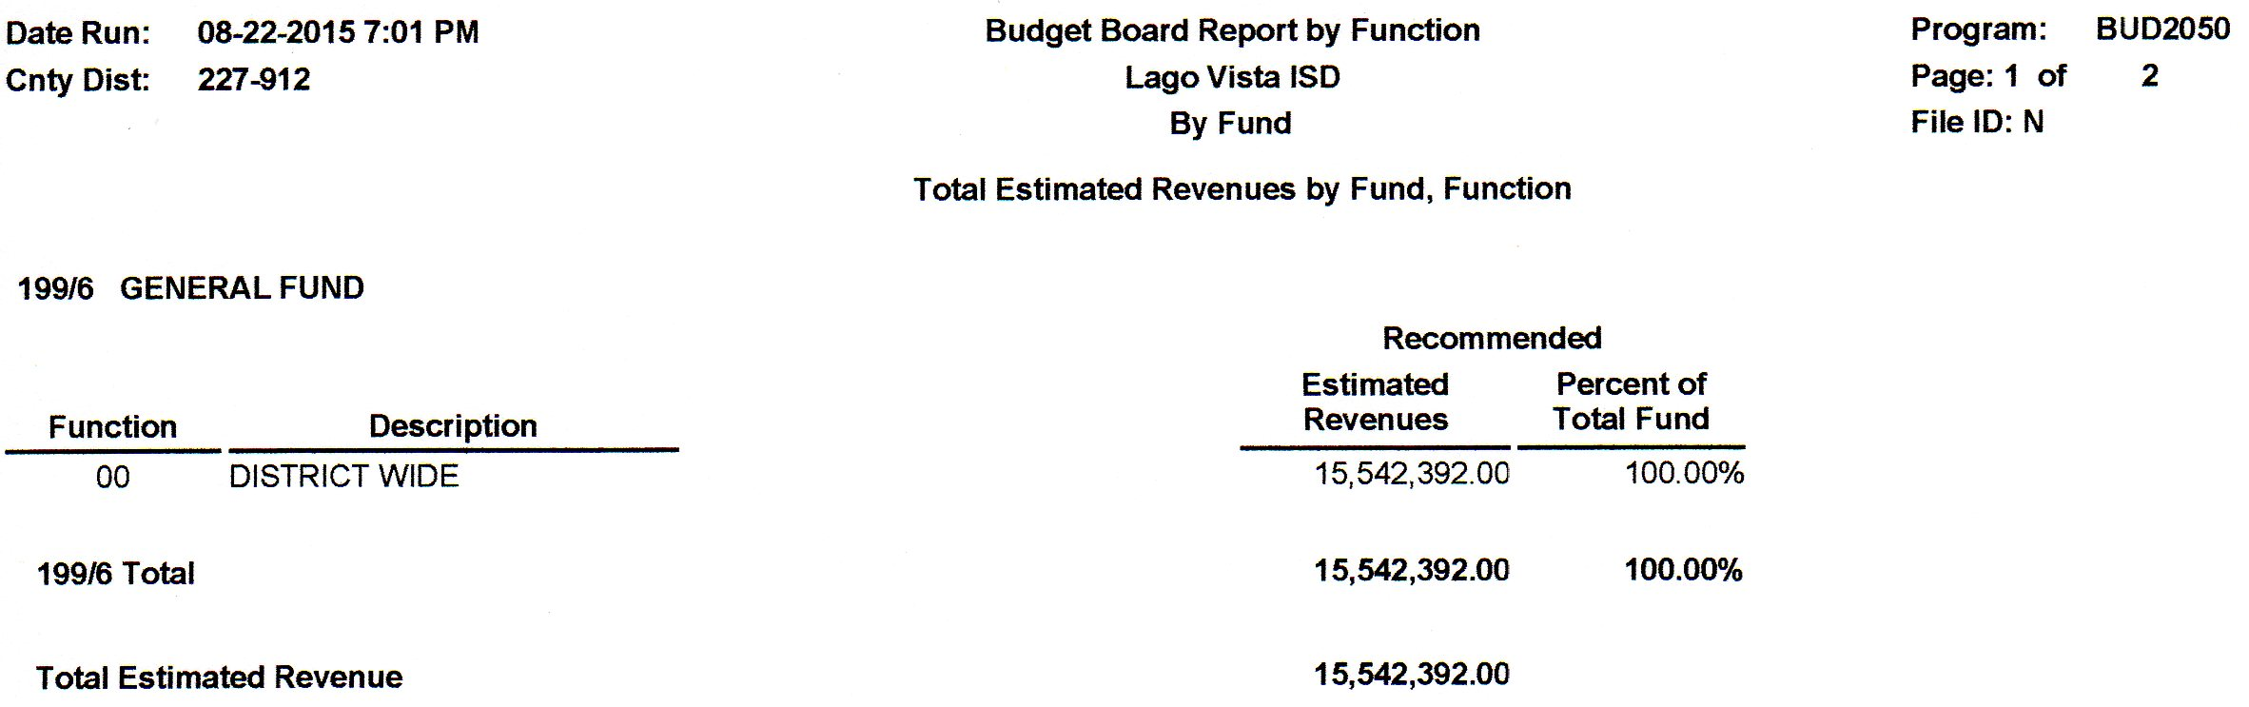
What to Take to the Board for approval

Slide 23
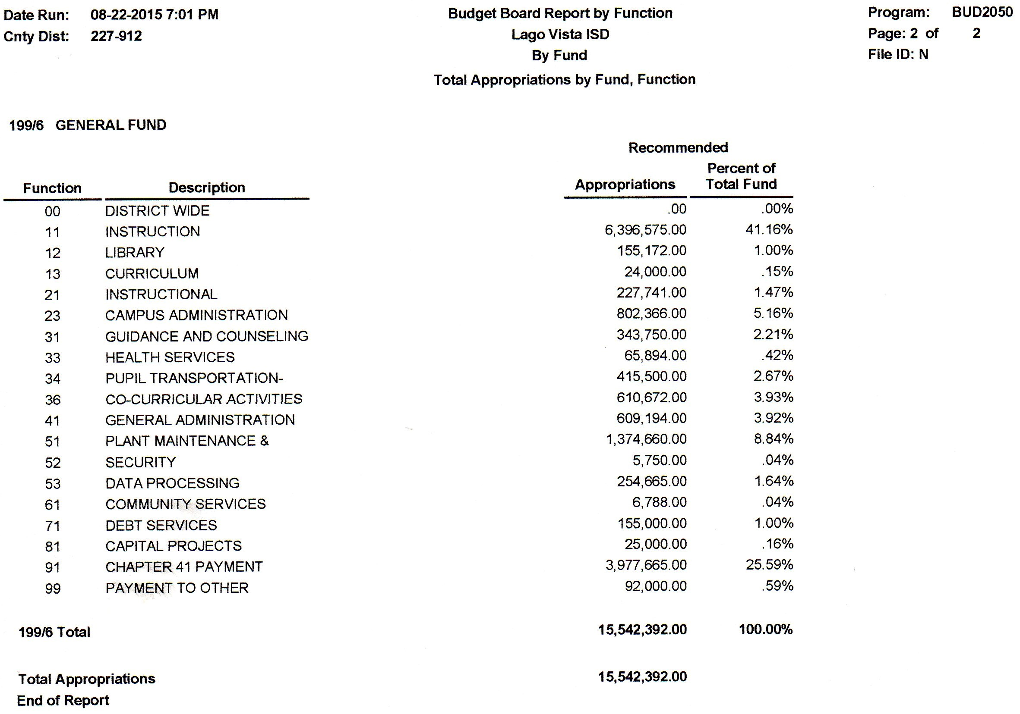
What to take to the board

Slide 24
Proposed changes to first
Change in fund balance: over 3 years decrease less than 25% or exceed 75 days operational expenditures
Difference in projected ADA and actual ADA within the allotted range
Required publications published on website (adopted budget, prior two years’ budgets, AFR, superintendent’s contract, check registers, utilities, etc.)
Discussion of district’s property values and the tax collection lag (within 120 days before adopting the budget)

Slide 25
Proposed changes to first
Less than a 10% variance between budgeted revenues and actual revenues for the last three years.
Untimely payments to TWC, TRS, IRS and other governmental agencies
There were other changes to FIRST in assigned points and changes in regards to districts with debt that are not included here.

Slide 26
What can you do now?
Begin the Budget Process for 2018-2019
Enrollment numbers
Staff numbers
Projected revenues
Projected expenditures – salary schedule, contracted services, projected utilities, fuel, program changes, etc.
Run a new template with updated numbers each six weeks

Slide 27
Education Service Center 15
Henri Gearing - Coordinator of Financial Services
830-683-7615

